Slide 1

On-the-fly-reconstruction
The large area imaging detector array is located where the black dot is in the middle of the bottom edge of the rectangular image. The height of the image corresponds to just over 100 meters. The image is "developed" as the vehicle moves from left to right. In this animation, the reconstructed image is slid off to the left at the same rate, so that the detector array appears to remain stationary while the recovered image moves to the left. Detected in sequence are: a 2 mCurie source at 100 m, then a 0.5 mCurie source at 25 m, followed by a 1 mCurie source at 50 m.
Notes:
This video shows a large area imaging detector.
The top of the picture is about 100 meters away.
The image is developed as the vehicle moves left to right.
The reconstructed image moves from the right to the left so the detector appears to remain stationary.
The detected sources are a 2 mCi source at 100 m and a 0.5 mCi source at 25m followed by a 1 mCi source at 50 m.

Slide 2
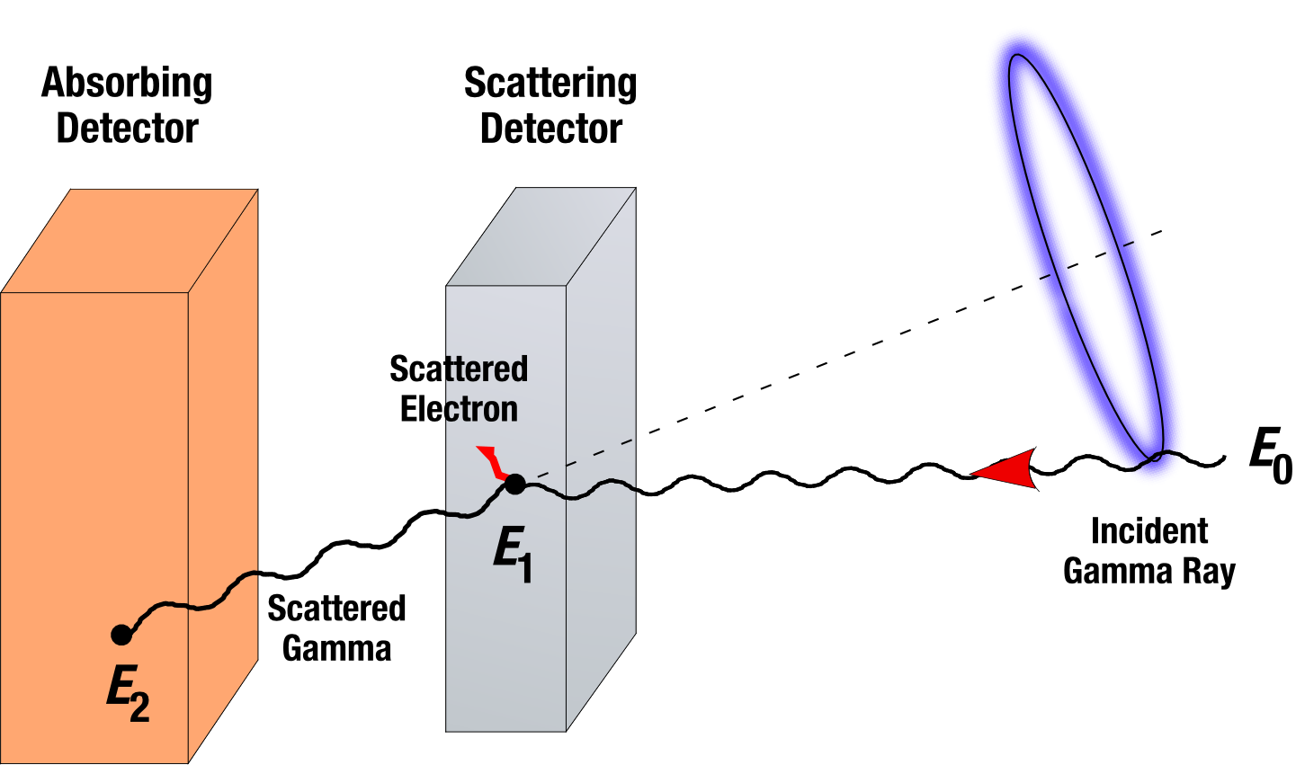
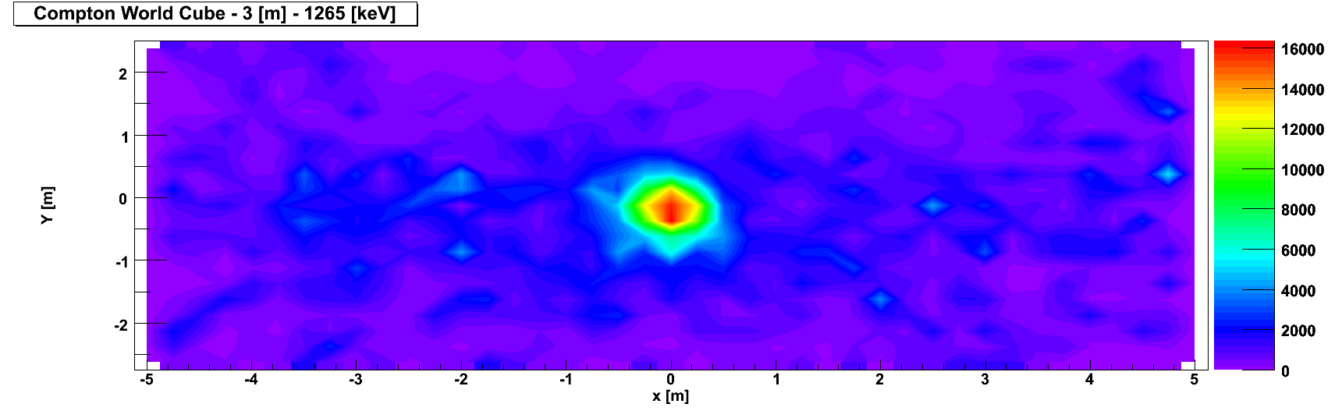
Compton imaging
Why might this method not be as effective for lower energy photons?
Notes:
How does Compton imaging work?
(1) A photon is emitted from somewhere
(2) The photon interacts in the scattering detector. The photon is scattered at an angle that depends on the incident energy. You know how much energy was given to the scattered electron because it is deposited in the detector.
(3) The photon is absorbed in the second detector and you record the energy of the scattered photon.
(4) You can back out a “cone” (actually a ring) of where the gamma originated.
(5) After many such events, the “rings” intersect and you have the point for the source location.
Note that this graphic is certainly not drawn to scale!!!
Why is this method less effective for lower energy photons?
Less effective for low energy due to absorption in first detector and many other issues.

Slide 3
Combine visible and gamma-ray imaging…
K. Ziock, et al., IEEE TNS 55, 3654 (2008)
Notes:
Here is a test where visible and gamma-ray imaging are combined to track a vehicle moving with a source.

Slide 4
Compton/coded aperture/hybrid imaging
Notes:
There graphics show a combination of Compton imaging and a coded aperture to create a hybrid image.
Individually, the Compton imager and coded aperture appear to show a source.
When you combine both images, using the information gleaned from both, you identify the “true source” and correctly identify there is no source to the right.

Slide 5
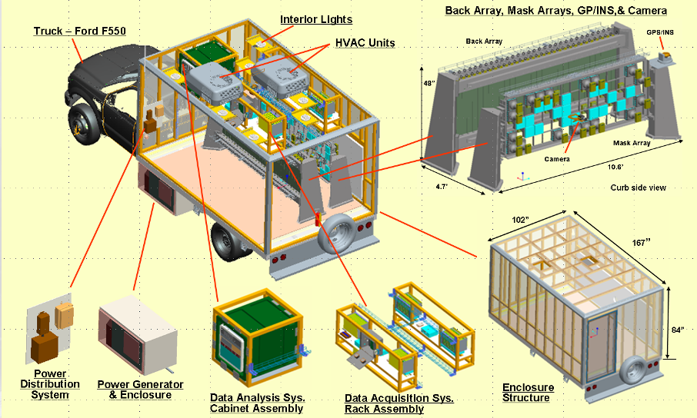
SORDS imaging system
Notes:
Stand Off Radiation Detection System using a combination of coded aperture and Compton imaging. Raytheon worked on this project with LANL, Bubble Technology, and MIT.

Slide 6
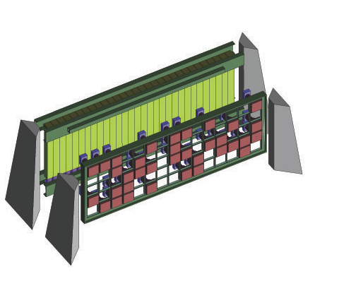
Using both Compton and coded aperture information
Position sensitive absorbing detectors (NaI bars)
“Active” mask (NaI tiles)
Notes:
Here is a graphic of an arrangement of detector showing from “active mask” and rear position sensitive detector for imaging.

Slide 7
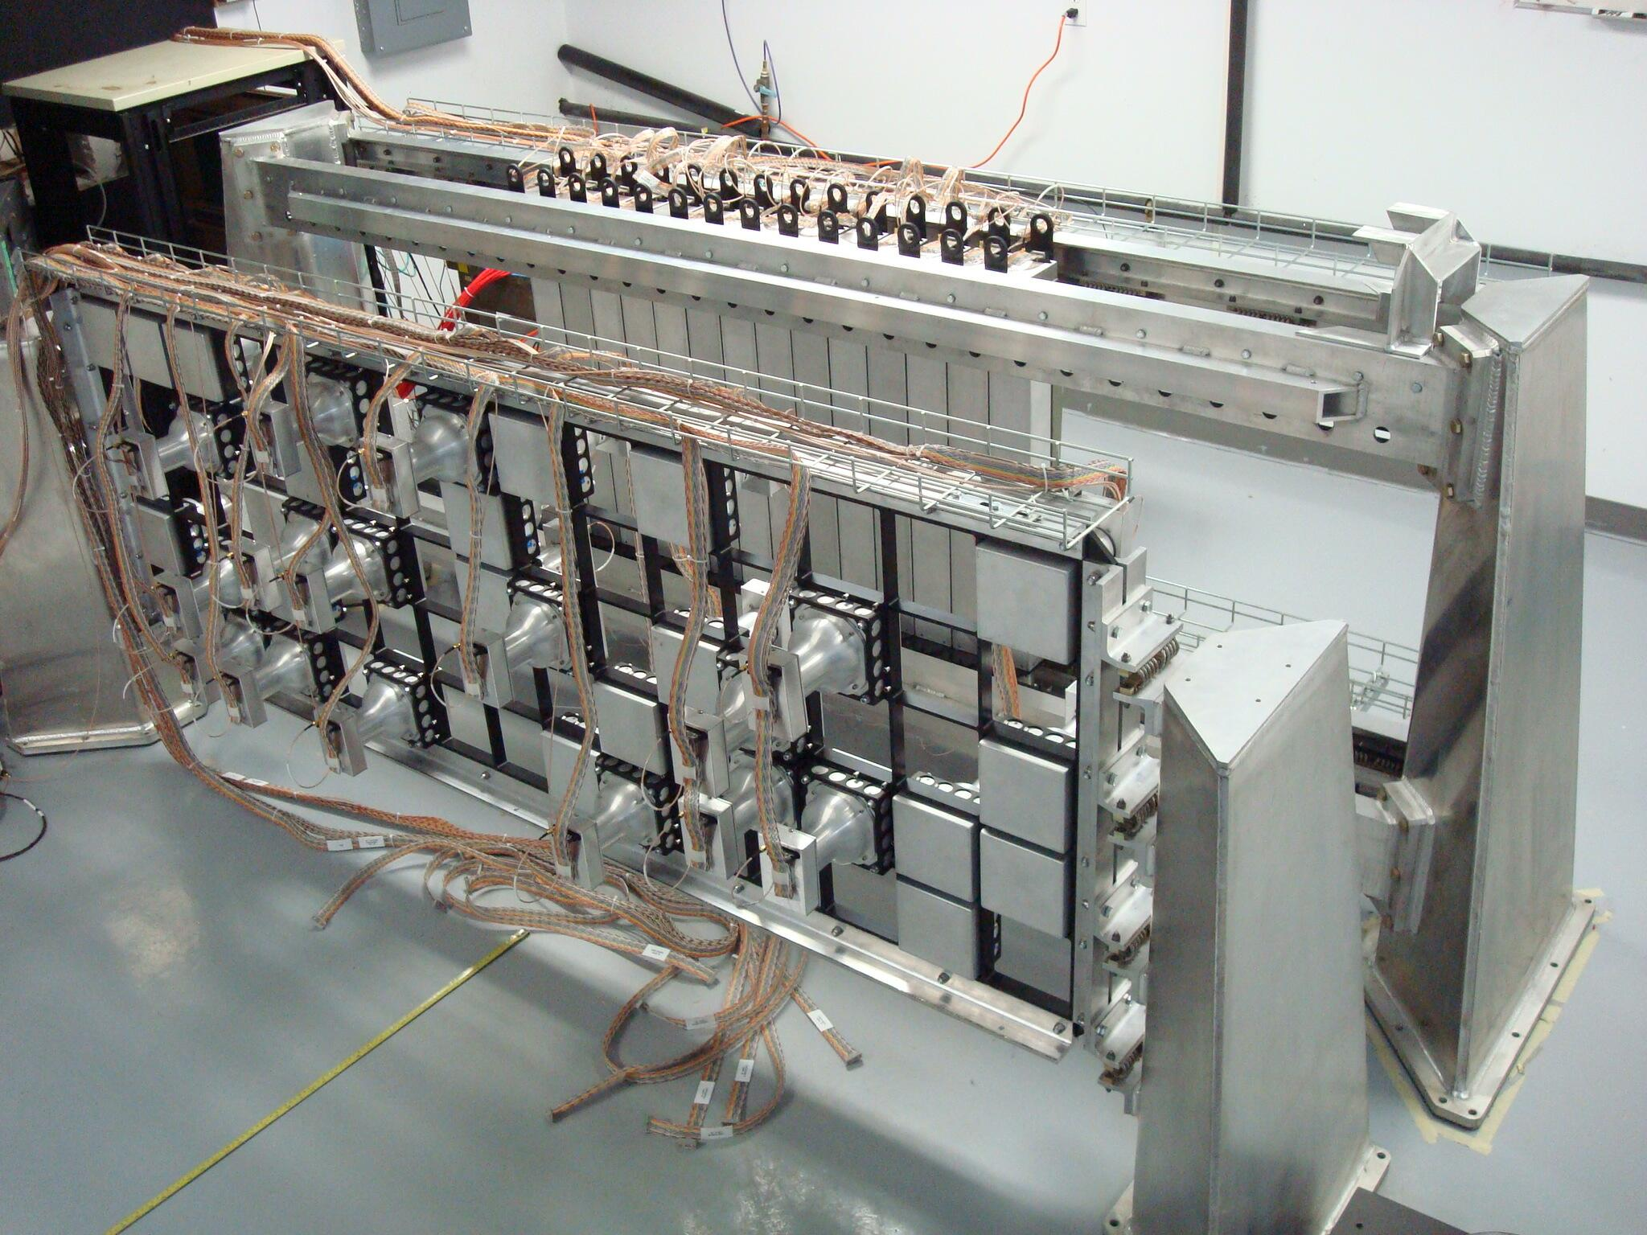
Coded aperture and Compton arrays
Notes:
And here is what it would look like in real life.

Slide 8
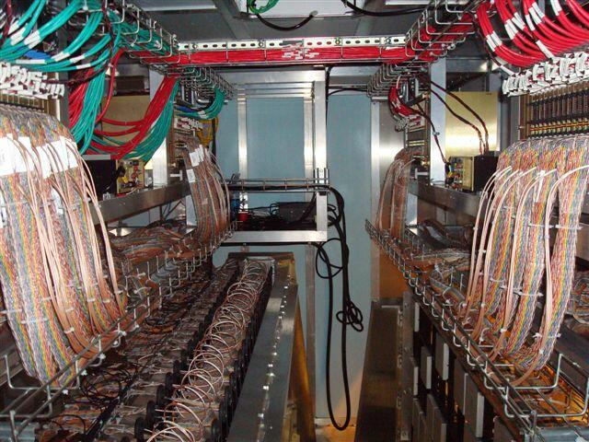
Interior of the truck

Slide 9
Directional sensitivity based on multiple events (1)
H. Yamanishi, NIM A 544, 643 (2005)
- polyethylene block and 4 ³He tubes
- minimize response difference between four ³He tubes
Notes:
The polyethylene scatters the neutrons.
Since lower energy neutrons are more easily detected (why are they more easily detected?),

Slide 10
Directional sensitivity based on multiple events (2)
Notes:
(Fig 2): Calculated respond of the Det-R and Det-L in regard to the angle of incidence for a neutron energy of 0.1 MeV
(Fig 3): Same for an energy of 1.0 MeV
(Fig 4): Same for an energy of 10 MeV
Right: Difference between experimental results and MCNP predictions.

Slide 11
Neutron scatter camera (1)
N. Mascarenhas, et al. Sandia National Lab
First scatter
Second scatter: TOF
Finite position resolution
Energy uncertainty
Notes:
How does this work?
Backing out, from the scatters, where the neutrons came from.
From the detectors, there is uncertainty in where the scatter(s) occurred.
There is also associated energy uncertainty.

Slide 12
Neutron scatter camera (2)
fast PMTs, liquid scintillation detectors in two planes
utilize pulse shape discrimination and TOF to distinguish between gammas and neutrons in each detector plane
Notes:
Actual picture of the device.

Slide 13
Neutron scatter camera (3)
pulse shape discrimination
relative efficiency
Notes:
Do we ever really have neutron sources without gammas?
What is pulse shape discrimination and how does it work?
An ability to differentiate between the type of particle (photon or neutron) which (indirectly) caused the energy deposition.
For the same energy deposition, the charge created should be about the same.
Rise times for pulses are the same.
However, based on the mechanisms (electron from gamma or proton from (n,p)) the distribution of the energy is different.

Slide 14
Neutron scatter camera (4)
detection of neutron source on tanker
3 sigma CL in >5 min
< 2 hrs
detection at 30 m
Notes:
And here are some images from the neutron scatter camera.

Slide 15
How can we improve HEU detection?
Improved method
Passive detection - Gamma-ray imaging - Networks of detectors - Improved signature recognition
Active detection - Gamma-ray interrogation - Neutron interrogation
Improved detector materials
Payoff
Passive detection
Improved signal-to-noise
Provides effective increase in detector size
Improves signal-to-noise
Active detection
Highly penetrating through low-Z material
Highly penetrating through high-Z material
Operational improvements; better energy resolution, lower power, smaller size
Notes:
We saw all of these methods that “allow” identification of radiation sources. But how practical are they?
Can you place something at the border that takes a minute to scan?
How would this affect commerce?

Slide 16
Conclusions and recommendations from an earlier workshop (2000)
The detection of HEU in nuclear weapons is extremely difficult
Currently available technologies do not provide high confidence
Research and development of HEU detection methods should be pursued for both passive and active techniques to include:
Active interrogation
Gamma-ray imaging
Improved signature recognition methods
Detector networking
New detector materials
Notes:
I place this in here because the conclusions never change…
In order to be successful, we need to have some sort of a breakthrough.
What kinds of considerations are there to active interrogation? What about the political / social aspects of “irradiating” food or stowaways?
What about gamma-ray imaging? Can we really afford to spend the time?
Improved signature recognition methods? Is this a matter or algorithms or synergy of information?
Detector networking? Can we develop large systems that talk to each other?
New detector materials? NaI(Tl) is the most commonly used scintillator and its been around since we started. Is there a next step?

Slide 17
Background is relatively unimportant
Figure of merit for low activity (small Compton)
where D(E) = min detectable activity (Bq), A =1/precision (=10 for 10%),
t = count time, ε = efficiency, f = branch ratio, b = integration width in fwhm, R = resolution (keV), E = energy, B = background (ct/s·keV)
[rewritten from J. A. Cooper, NIM 82, 273, (1970)]
Detection limit or throughput scale as ε/√B, so you should buy Ge rather than Pb
Nonetheless…
Notes:
where
D(E) = minimum detectable disintegration rate, Bq
A = reciprocal of the desired fractional precision (=10 for 10%)
t =counting time, s
ε(E)= detector efficiency, counts/photon
f(E) =gamma ray yield, photons/decay
R(E) =detector resolution (fwhm), keV
b =peak integration width, in multiples of the fwhm
B_{C}(E) = Compton baseline rate, counts s-1 keV-1
B_{n}(E) = natural background rate, counts s-1 keV-1

Slide 18
Bulk shielding materials
Selected (non-radiogenic) lead
Minimal U, Th products (²¹⁰Pb 22 y t_{1/2})
8 cm attenuates 1.46 MeV ⁴⁰K γ by 100x
Selected (pre-nuclear) iron
Requires 12 cm for 100x attenuation
But (µ,n) rate per kg is 1/4 of that in Pb
Copper
Can be very clean
Electrorefining underground in extreme case

Slide 19
Avoiding muon background
If you want to reduce the impact of cosmic ray muons should you add more shielding?
What do we do? We go underground (but that’s not practical for what we want to do)
Reduced 5x in 50 m water equivalent at NASA RCL
1/1000 at 500 mwe (150 m rock)
1/2x10⁶ at 1.4 km rock (Gran Sasso)
Surround detector with anticoincidence mantle
Notes:
No, adding shielding means more interactions / energy deposition.

